Slide 1
POWER BI · PL-300 · PROJECT 1
Summit Outfitters
Sales Analysis — a data analysis project
Presented by: [ Andreas Wong]
Date: [ 10/08/2026 ]

Slide 2
2
Project Brief
Overview
Objectives
Summit Outfitters is a US outdoor-gear retailer that has grown for three years on instinct and spreadsheets. The order data has never been analysed. Your job: turn the raw exports into one report that shows how the business is really doing.
Connect to and clean the raw data
Model it into a star schema
Build the DAX measures
Deliver an interactive report and written insights
Key questions the report must answer
How much revenue, cost & profit — and the margin?
Is the business growing year over year?
Which categories & regions drive profit?
Are we on track vs the $1,550,000 FY2024 target?
Where are our customers, geographically?
When in the year do we sell the most?

Slide 3
3
Dataset Overview
Source: Six raw CSV files from Summit's systems — three yearly order files, a customer list, a product catalogue, and a state-to-region lookup.
6,700
2022–24
220
36
26
order lines
three years
customers
products
states
Relevance to the project
The data spans sales, products, customers, geography, and time — every dimension the business questions need. Revenue, cost, and profit come from the order lines and the product costs; growth comes from three years of dates; and the customer states let us map demand. It is enough to answer all seven questions end to end.

Slide 4
4
Dataset Structure
Key variables by type
Categorical
Category, Subcategory, Region, State, Segment, Channel
Numerical
Quantity, Unit Price, Discount, Unit Cost
Date
Order Date
Keys / IDs
Order ID, Customer ID, Product ID (Key columns all hidden, IDs not summarised)
Delivered as related tables — clean each, merge Region into Customers, and set the relationships.

Slide 5
5
Identified Problems in the Dataset
Found by profiling the columns (column quality & distribution) before modelling:
!
!
!
!
!
Text dates
Blank values
Combined names
Inconsistent text
Order Date stored as text, not a date
Discount blank when there was none
Customer Name is one 'First Last' field
Casing & spaces in Segment, Channel, State
!
!
!
Inconsistent categories
Partial year
Duplicates
'Foot wear', 'Shoes', 'Tent' variants
2024 runs to August only
12 repeated order rows across the files

Slide 6
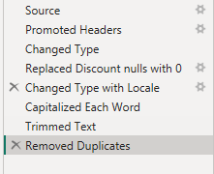
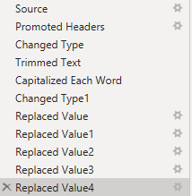
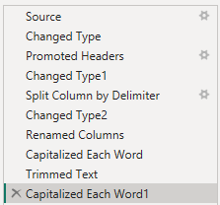
6
Data Cleaning Process
Cleaning done on each orders dataset (2022-24)
YOUR TASK For each issue you found, record the step you took and why.
Issue (from profiling)
Your fix & justification
→ Changed the data type to short date,
so that there are no issues when
creating date table/using dates
Text dates →
Combined customer name →
→ Splitting the customer's name column
into first and last name so that it is
easier to sort and filter by name
Cleaning done on products dataset
Inconsistent text & categories →
→ Making sure that all categories are
consistently cased and spaced allows
for more accurate grouping. Also changed
‘Shoes’ Category to ‘Footwear’
Blank discounts →
→ Replaced the blank values in discount
with 0, Power BI will not read the blank
values as 0 so I needed to change them
Cleaning done on customers dataset
Duplicate rows →
→ Removed duplicates from each order
table to improve the quality of the
data, ensures data consistency and
accuracy
Tip: the Power Query Applied Steps list is your audit trail — every fix should appear there so the pipeline survives a refresh.

Slide 7
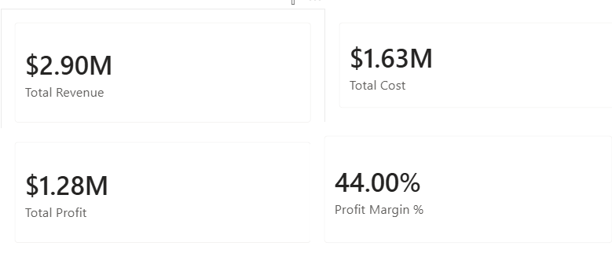

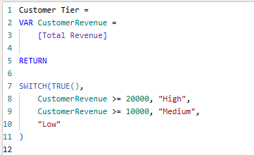
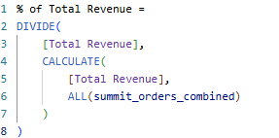
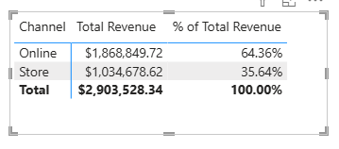
7
Data Transformation
YOUR TASK Show what you built on top of the clean data.
Above are the measures required for step 4; Total Revenue, Total Cost, Total Profit, and Profit Margin
Above is the measure I created for % of Total Revenue, and using channel as an example to show that the total revenues add up, and the percentages add up to 100.
Above is the DAX code used to create the column Customer Tier (verified manually that the column was calculated correctly).

Slide 8
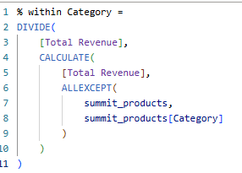
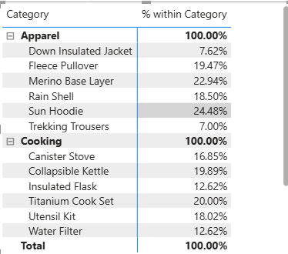
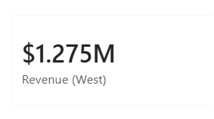

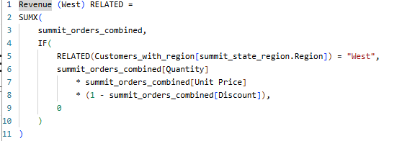
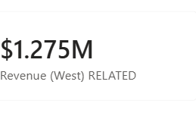
Data Transformation (Continued)
To the left is the measure for % within category, and a matrix to verify that the percentages add up to 100%
To the left here is the measure for Revenue in the West Region, and the card with the value. (I verified this was correct by filtering the Total Revenue measure by Region.)
I noticed the marking scheme awards marks for using RELATED, but I couldn’t find a good place to use it, so instead I created a new measure for calculating Revenue in West region which does use RELATED and gives the same answer

Slide 9


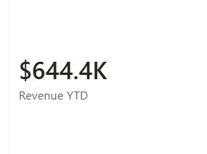
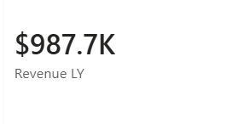

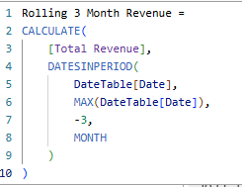
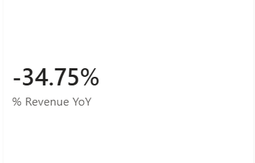
Data Transformation (Continued)
Since the data for 2024 only goes up to August, using SAMEPERIODLASTYEAR in the Revenue LY measure here essentially calculates the total revenue from the period January 2023-August 2023 (to make comparisons fair). I verified this because the revenue for the whole year of 2023 (1.29m) was more than the figure on the left.
This figure is for 2024
This is the measure used for calculating the three-month rolling revenue. (It will be used on the trend visual next slide).
Using the two figures above gives us the % Revenue YoY for 2024.

Slide 10
8
Exploratory Data Analysis
Total Order value: $2.9m,
Average Order Value: $433.36
Median Order Value: $326.28
Standard Deviation for Quantity: 1.12
Standard Deviation for Price: $123
Descriptive stats
Total & average order value, median, spread of quantity and price
Time pattern
Revenue by month — is there a clear seasonal shape?
Looking at the total monthly revenue, it does look like there is a seasonal shape, with peaks coming in Q2-Q3 (aka April-August).

Slide 11
9
Visual Analysis
My dashboard

Slide 12
9
Visual Analysis
My mobile dashboard

Slide 13
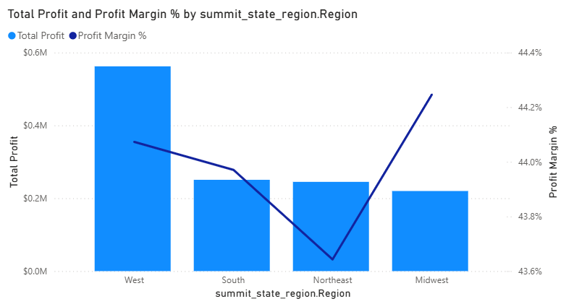
Additional visual: Region by profit margin
Shows that while West drives profit, the Midwest actually has the highest profit margin, although only by a tiny amount.

Slide 14
9
Visual Analysis
Insight into each visual
1
Revenue, Profit and Profit Margin by Category
2
Monthly Trend (line)
3
Region × Year (matrix)
I found that while tents are the best-selling category with $940k in revenue, and it is in fact Cooking (lowest revenue at $220k) which has the highest profit margin of 47.65%, compared to tents with 43.31%.
Looking at the total monthly trend, we can see a seasonal trend, with peaks coming in Q2-Q3 (aka April-August).
The west has by far the best total revenue out of all the regions, with double as much as any of the other regions. This is true for every year so far.
4
Revenue by State (map)
5
Revenue vs Target (KPI)
When zooming in on the map, hovering over each bubble showed the state’s total revenue, I found that California and Oregon were the states with the highest revenue, Pennsylvania and Vermont had the lowest.
As of August 31st, the total revenue for 2024 is $644k, against the target of $1.55m. Annualising our 2024 revenue suggests we should reach $967k at the end of the year. Further analysis on the next slide.

Slide 15
10
Insights & Findings
YOUR TASK Answer each business question with your numbers.
2
Year-over-year growth → Slide 9 gave us the figure for year-on-year growth coming into August 2024, which was -34.75%, which means that compared to this time last year in August 2023, we have a much lower total revenue. Year on year growth was positive 2022 -> 2023, with a figure of 33.47%. The business grew in 2023, but now in 2024 it is no longer growing.
1
Revenue, cost, profit & margin → For the three year period, total revenue is $2.9m, total costs are $1.63m, total profit is $1.28m and the profit margin is 44%.
For 2024 specifically, total revenue is $644.440, total costs are $361,800, total profit is $282,550.
Top categories & regions by profit → Our top category is tents with $407k in profit. However, although it leads in this metric, in terms of profit margin, Cooking is the leading category with a profit margin of 47.65%. In terms of regions, West is the best in terms of profit with $562k, but looking at profit margin, it is the 2nd highest with 44.07%, with the Midwest region having the highest profit margin (44.25%).
3
4
On track vs the $1,550,000 target? → We are currently not on track to meet the target. As of August 2024, we have a total revenue of $644,400. Annualising this gives us (644/8) * 12 = $967k run rate, which makes us roughly 38% off the current target. Considering seasonality, we are not likely to be able to make up the remaining $906k in the last four months of the year.
5
Where the customers are →Looking at the count of customer IDs in each region and state, most of our customers (97) are in the west region, and in the states California, Colorado and Oregon (14 each).
6
Seasonal peak → Seasonal peaks occur in late spring and summer (April-August) as seen by looking at the line graph visual in the dashboard. May 2022 and 2023 showed as the months with highest revenue, but in 2024 the peak happened slightly later in June 2024 instead.

Slide 16
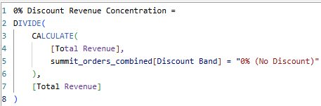
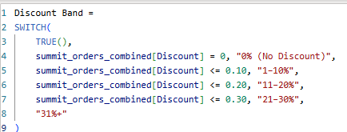
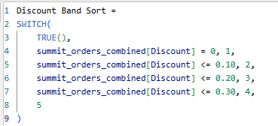
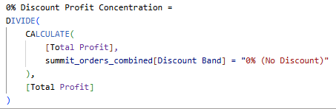
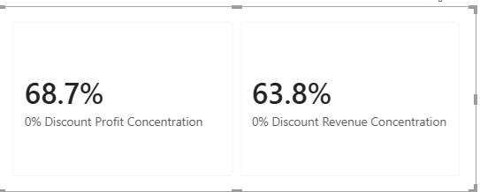
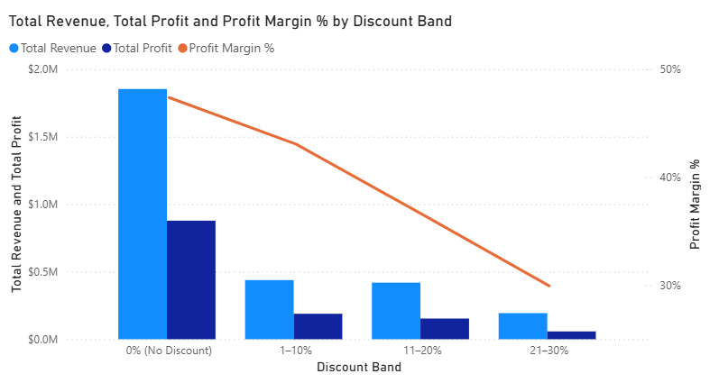
11
Discount Impact Analysis
We can see here that revenue and profit decrease as the discount band increases. Notice that that despite defining a band for 31%+, it is empty and hence doesn’t show on the visual.
However, this on its own doesn’t tell us too much as to how discount bands affect revenue and profit.
The profit margin gives us a better analysis. The line in the graph shows that a higher discount band is associated with lower profit margins. Compare the profit margin at 0% discount (47.38%), with profit margin at 1-10% (43%), to profit margin at 11-20% (36%), to profit margin at 21-30% (30%).
The figures above show that the 0% discount band contributes to 68.7% of profit and 63.8% of revenue, showing it is profit engine.
My advice on how this should affect pricing is on the next slide.
3

Slide 17
12
Recommendations
YOUR TASK Turn the insights into 3–4 actions leadership could take.
1
Where to invest
2
Advice on discounting
As seen in the last slide, a higher discount band is associated with lower profit margin. To recap the profit margins: at 0% discount (47.38%); profit margin at 1-10% (43%); profit margin at 11-20% (36%); profit margin at 21-30% (30%).
One might think that a 1-10% discount would be the best balance between profit margin and discounts for customers. However, seeing as we already have a large revenue gap from now to our FY2024 target of $1.55m, we probably can’t afford to widen if further by offering discounts, especially as analysis showed that the 0% discount band is the biggest driver of revenue and profit, which is what the business needs.
Our strongest region is clearly the West. We could go one of two ways, either further invest in this region and category to take advantage of this, or we actually try and invest improve sales in the other regions. I would advise the former, as the main reason for West being the best-selling region is because that’s where most of our customers are. However, it must be noted that in terms of profit margin, the Midwest is actually slightly ahead (44.25% compared to 44.07%), so maybe we could also invest more in the Midwest.
In terms of categories, although tents is the volume driver in terms of revenue and profit, Cooking actually has the highest profit margin (despite having the lowest revenue and profit), so in this case it might be worth investing more in the Cooking category.
4
3
Plan for the season
We have identified that the period between April to August generates the most revenue. This means that during this month, we should make sure to increase stocks and staffing during these periods to cope with higher demand, while reducing stocks and staffing during the winter months where the trend line shows we have the lowest revenue.

